Slide 1
Study Game- Intolerable Acts
By: Victoria Lam

Slide 2
Question: What was the Intolerable Acts?

Slide 3
Answer: A series of Acts created by the ______ because ___________.

Slide 4

Question: Who created the Intolerable Acts?

Slide 5
Answer: The British Parliment

Slide 6
Question: Why were the Laws created?

Slide 7
Answer: Because of the Boston Tea Party

Slide 8
Question: What was the Boston Tea Party?

Slide 9
Answer: When the Sons of Liberty had dumped ___ chests of tea in ships into the water

Slide 10
Question: How many chests of tea were dumped into the water?

Slide 11
Answer: 342 chests

Slide 12
Question: When did they dump the tea into the water?

Slide 13
Answer: December 16, 1773

Slide 14
Question: What year did the British Parliament make the Acts?

Slide 15
Answer: 1774

Slide 16
Question: How many acts were there?

Slide 17
Answer: Five

Slide 18
Question: How many acts were there in direct response to the Boston Tea Party? (And what were they?)

Slide 19
Answer: Four: Boston Port Act, Massachusetts Government Act, Administration of Justice Act, Quartering Act

Slide 20

Question: Why was one of the Acts considered intolerable?

Slide 21

Answer: It was passed during the same time and it had limited exploration and taken away some of the colonists’ homes

Slide 22
Question: What was the Boston Port act?

Slide 23


Answer: An act that stated that no ships were allowed in or out of the Boston port

Slide 24

Question: What did the Parliament do to enforce the law?

Slide 25

Answer: They had a blockade and had soldiers monitor the port.

Slide 26
Question: When was this passed and when did it take effect?

Slide 27


Answer: March 31, 1774 AND
June 1st

Slide 28
Question: Why were colonists angry at this?

Slide 29

Answer: Because now they had a harder time trying to earn money and resources they needed

Slide 30

Question: What were the other colonies’ responses to this?

Slide 31
Answer: They felt bad for them, so they sent them supplies (“relief supplies”)

Slide 32
Question: How did this bring the colonies for the first time together?

Slide 33

Answer: They felt bad for Boston, so they helped out

Slide 34
Question: What was the Second Act?

Slide 35
Answer: The Massachusetts Government Act

Slide 36

Question: When was it passed?

Slide 37
Answer: May 20th, 1774

Slide 38
Question: What did it do?

Slide 39
Answer: It stripped colonists of their voting privilege and the now the King / governor assigned could appoint roles and they could not have town meetings.

Slide 40
Question: Why did they do this?

Slide 41
Answer: They thought this was one of the causes of the resistance of the people (Lack of government power)

Slide 42
Question: What was the third act?

Slide 43
Answer: Administration of Justice Act

Slide 44

Question: When was it passed?

Slide 45
Answer: May 20, 1774

Slide 46
Question: What was it also referred to and why?

Slide 47
Answer: The Murder Act and because officials could get away with murder

Slide 48
Question: What did the act do?

Slide 49
Answer: It stated that any official charged with Capital offenses could be sent back to another colony or Britain for trial, so angry colonists could not testify against them.

Slide 50
Question: What was the Fourth Act?

Slide 51

Answer: The Quartering Act

Slide 52
Question: When was it passed?

Slide 53

Answer: June 4, 1774

Slide 54
Question: Which previous law did it enforce?

Slide 55
Answer: Quartering Act of 1765

Slide 56
Question: How?

Slide 57

Answer: Before, soldiers were allowed to be housed in unused buildings and inns and owners had to provide free food and supplies, but now it included private homes

Slide 58
Question: What was the fifth act?

Slide 59
Answer: The Quebec Act

Slide 60

Question: What was the Quebec Act?

Slide 61
Answer: An act that granted Quebec more land and freedom of religion (which appealed to the Catholic Church)

Slide 62
Question: What land did it give (Modern States)?

Slide 63
Answer: Illinois, Indiana, Michigan, Ohio, Wisconsin, Minnesota

Slide 64
Question: When was the act passed and when did it take effect?

Slide 65

Answer: June 22, 1774 AND May 1, 1775

Slide 66
Question: Was it a direct response to the Tea Party?

Slide 67


Answer: No; It was just passed during session as the others

Slide 68

Question: Why was it considered so intolerable?

Slide 69
Answer: Because some colonists had already settled there and now they had to move out

Slide 70
Question: Which famous figure was angry about this act also and why?

Slide 71
Answer: George Washington; Now colonies could not explore and expand their land

Slide 72
Question: Were the acts ever taken down and why?

Slide 73
Answer: Yes; American Revolution

Slide 74
Question: What 2 major events in American History followed?

Slide 75
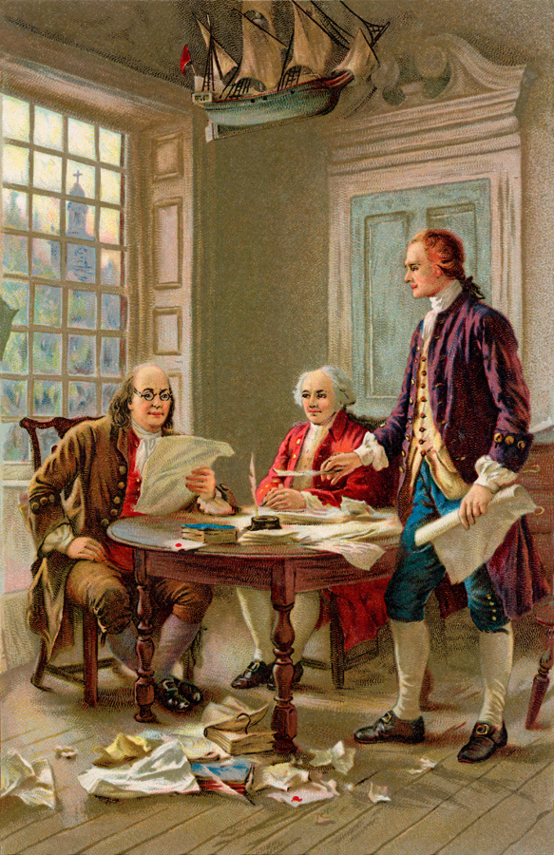
Answer: The Signing of the Declaration of Independence, The American Revolution, and Independence of the thirteen colonies

Slide 76

Tip for Studying:
If you miss something or get confused between two things, say it ten times without messing up.
Ex: You get mixed up with the color red being next to orange with green being next to blue. Say Red, Orange ten times and green, blue ten times.

Slide 77
Good Luck and Have Fun Studying!

